Slide 1
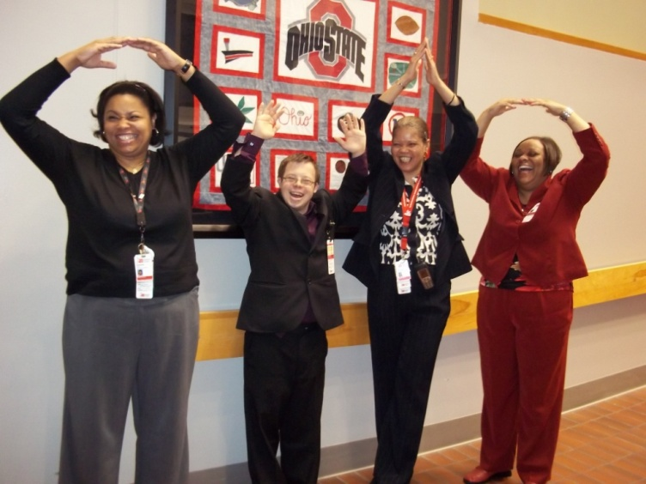
Going to College:
A Bridge to Employment for Students with Autism
August 11, 2015
Margo Vreeburg Izzo, Ph.D.
Margo.Izzo@osumc.edu
Thomas M. Hess, MA
Thomas.hess@dodd.ohio.gov

Slide 2
Project Goals
Develop and refine a statewide model that aligns with national standards and delivers inclusive
  College classes
  Career Exploration, Internships & Employment
  Campus membership
  Self-determination

Slide 3
Think College Standards
  THINK COLLEGE Standards & Quality Indicators*
      Academic Access
      Career Development
      Self-determination
      Campus Membership
      Alignment with College Systems
      Coordination and Collaboration
      Sustainability
      Evaluation
*http://www.thinkcollege.net/images/stories/TC_Standards_Site_Visit_Instrument_11-1-11.pdf

Slide 4
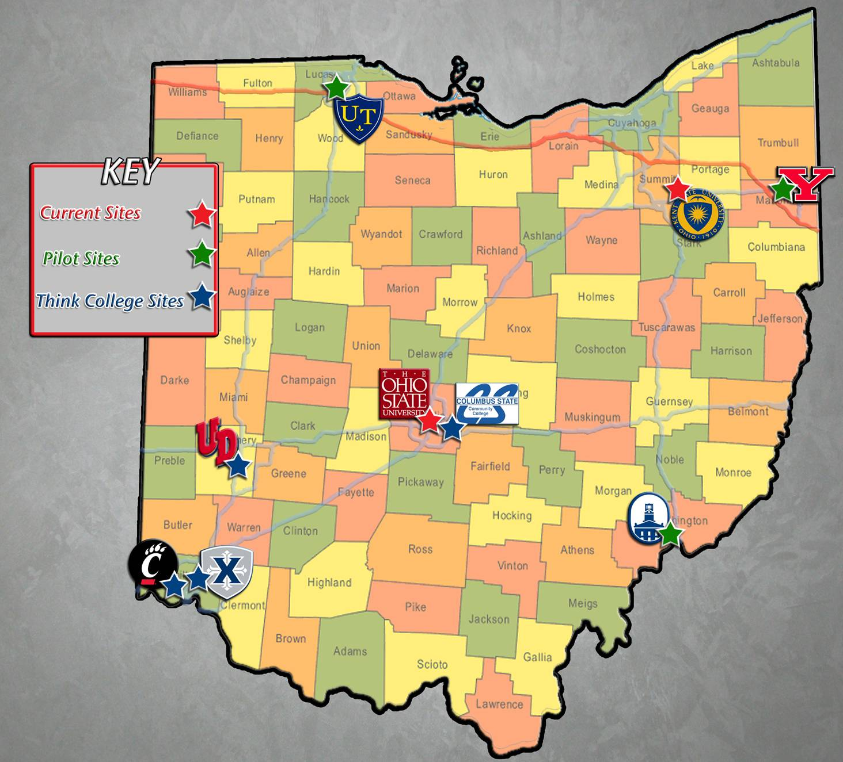
Postsecondary Options Across Ohio

Slide 5
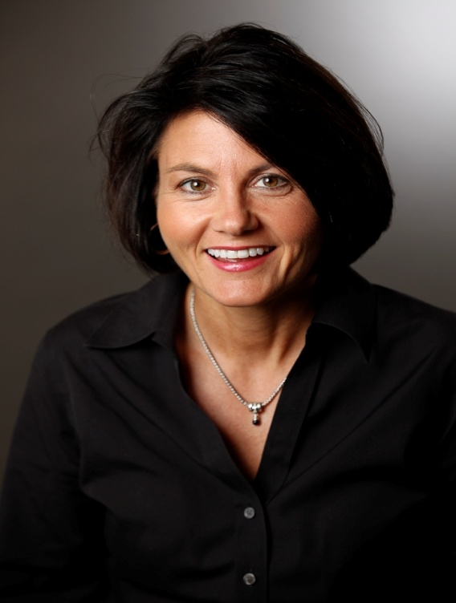
Replication Site Director
Dr. Darlene Unger, Youngstown State University
  Three year program serving HS students & young adults with autism
  Partners:
  Three colleges at YSU
  Rich Center for Autism
  Mahoning County ESC
  Mahoning County Board of DD
  And more….

Slide 6
Governor Kasich’s Executive Order
Employment First
Established community employment and school-to-work transition as priorities
PwDD have the right to make informed decisions about where they work
Improve and coordinate efforts to increase community employment outcomes
Less than 6% of DD adult service funds spent on integrated employment services
  We need more PSE Options in Ohio!

Slide 7
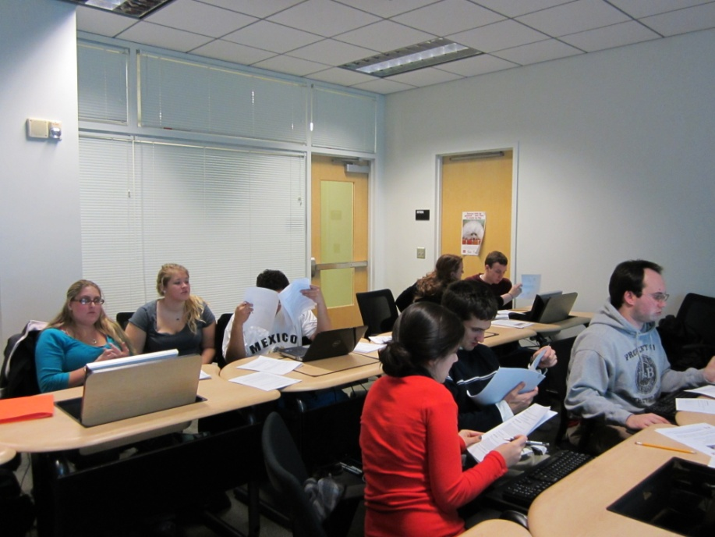
Academic Access
Art & Sciences 5191: Disability Studies Internship Class
  Inclusive class offered for educational coaches/TOPS students
Evaluation
  Faculty and Educational Coach Evaluations

Slide 8
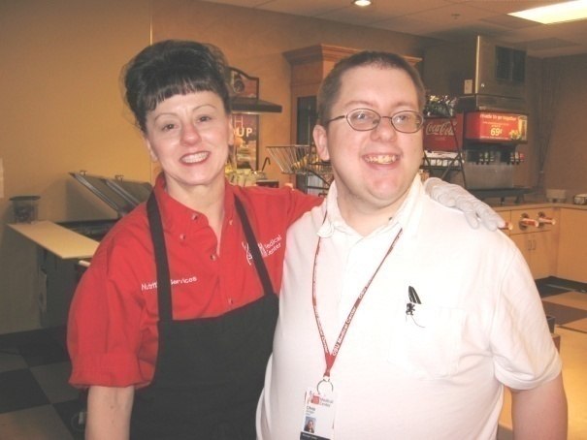
Career Development:
Project SEARCH = Employment
Total OSU Employees 41,921
Sample Positions:
  Tenure Faculty 2,930
  A & P Staff 16,710
  Civil service 5,277
  Student employees 13,680
Current OSU estimates indicate that 1600 employees with disabilities have disclosed
their disability.

Slide 9
Informational Interviews &Internship Sites
  TOPS students interview Art/Music Faculty
  TOPS students mentored by Art/Music Students
  Internship Sites:
  Art Class – Classroom Assistant (passes out supplies, etc)
  Drake Theatre – Stage Crew
  Student Recreation Center – Equipment check out
  UniPrint – Print Shop Assistant
  Columbus Zoo – Customer Service

Slide 10
  2014-2015 Employment Data
  N=14 students
100% engaged in permanent employment at exit from TOPS
Businesses include:
  Columbus Zoo, OSU James Hospital, Fed Ex
Average wages earned in paid positions = $9.29 per hour
Average hours worked per week = 24
OOD Report Card indicates an 83.33% successful closure rate among completers and students who exited early
  We need more PSE Options in Ohio!

Slide 11
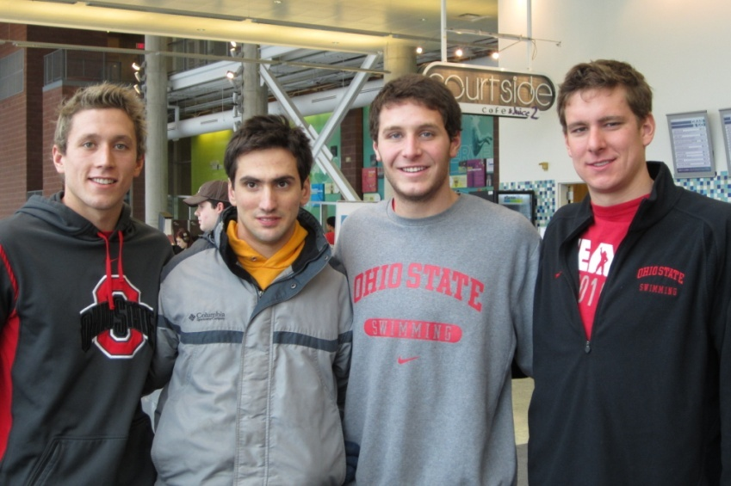
Campus Membership
Use Buck ID to ride campus transportation buses
Use RPAC pass to workout
Complete EDUPAES 270.01: Self Career Development
Enroll in Music 288: R&B and Hip Hop
Meet with educational coach two times a week
Independently navigate from internship to classes and meetings
Meet regularly for lunch with mentors
  We need more PSE Options in Ohio!

Slide 12
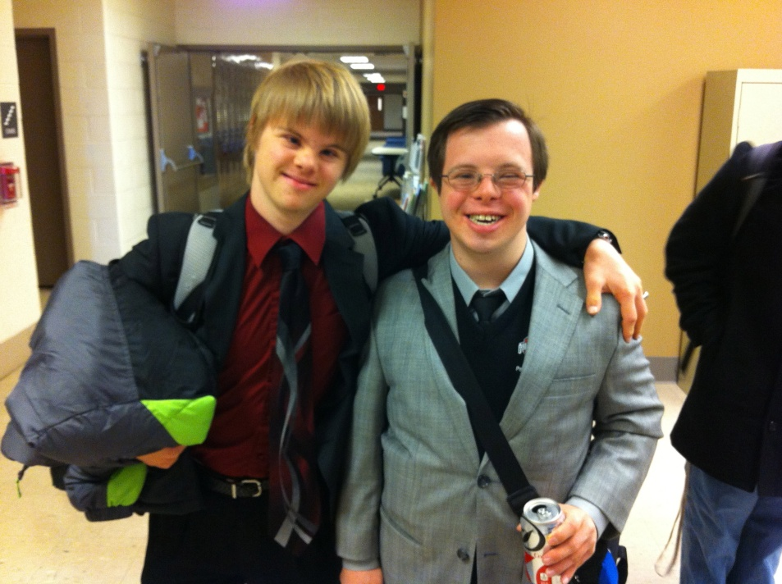
Self-Determination
Person-centered Planning Meetings
  Student-directed meetings
  Self-advocacy plans developed/practiced
  Courses selected based on interest/need
  Internships selected based on preferences/skills
  Quarterly goals established
  E-portfolio and Digital Stories
  We need more PSE Options
  in Ohio!

Slide 13

Youngstown State University – TOPS
Program of Study
Completion of 66 units = YSU Certificate
Goal: Min. requirement of 21 units/per AY
9 TOPS Core Courses
    Self-determination
    Technology for learning, living, and careers
    Financial literacy
    Community living skills
    Communicating and advocacy in the workplace and community

Slide 14

YSU - Campus Membership
Orientation and Advising
Access to 28 Inclusive Classes & more based on student interest
Peer Supports
YSU ID - Access to University Services
  Andrews Student Rec. & Wellness
  Technology & Library Services
  University Shuttle
  Cultural & Sporting Events

Slide 15
Shakespeare and Autism Project
Research Project w Royal Shakespeare Company and Nisonger Center
Hunter Heart Beat Method
Results:
  Improved social skills
  Improved social interactions

Slide 16
Drama Productions
“In Here Out There”
Students in Ohio State’s Master of Fine Arts in Acting program have worked with children with autism in social skills training, inspiring the creation of the play. The nine students collectively wrote the piece as part of the MFA Acting Outreach and Engagement Project.

Slide 17
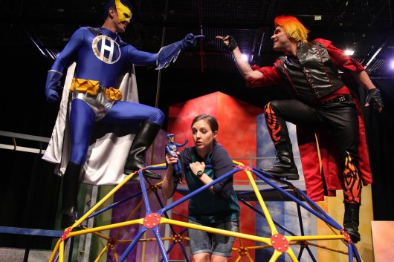
In Here Out There

Slide 18
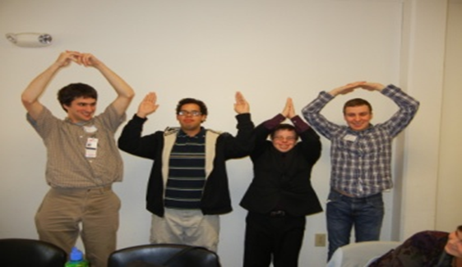
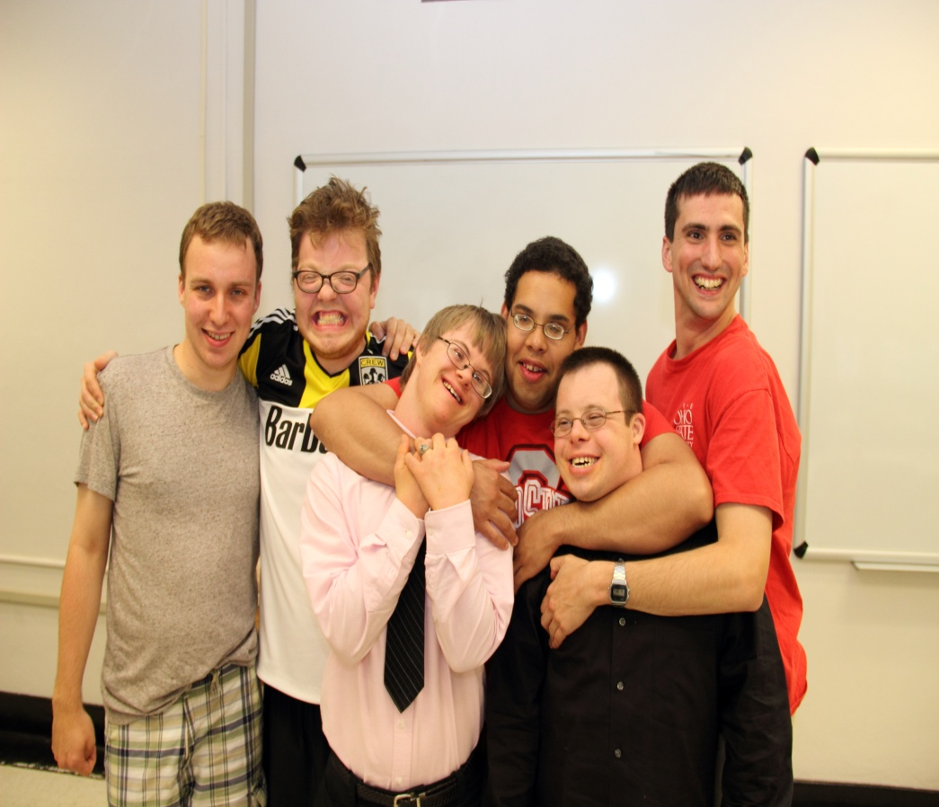
Hanging Out with TOPS Students

Slide 19
National Resources
1. Think College: www.thinkcollege.net
2. National Secondary Transition Technical Assistance Center: www.nsttac.org
3. National Collaborative on Workforce and Disability/Youth: www.ncwd-youth.info/
The 411 on Disability Disclosure: A Workbook
4. National Center for Secondary Education and Transition: www.ncset.org See Youthhood
5. Association of Higher Ed and Disability: www.ahead.org
6. Fast Facts for Faculty: http://ada.osu.edu/resources/fastfacts/index.htm
Fact sheets on 12 different topics

